Slide 1
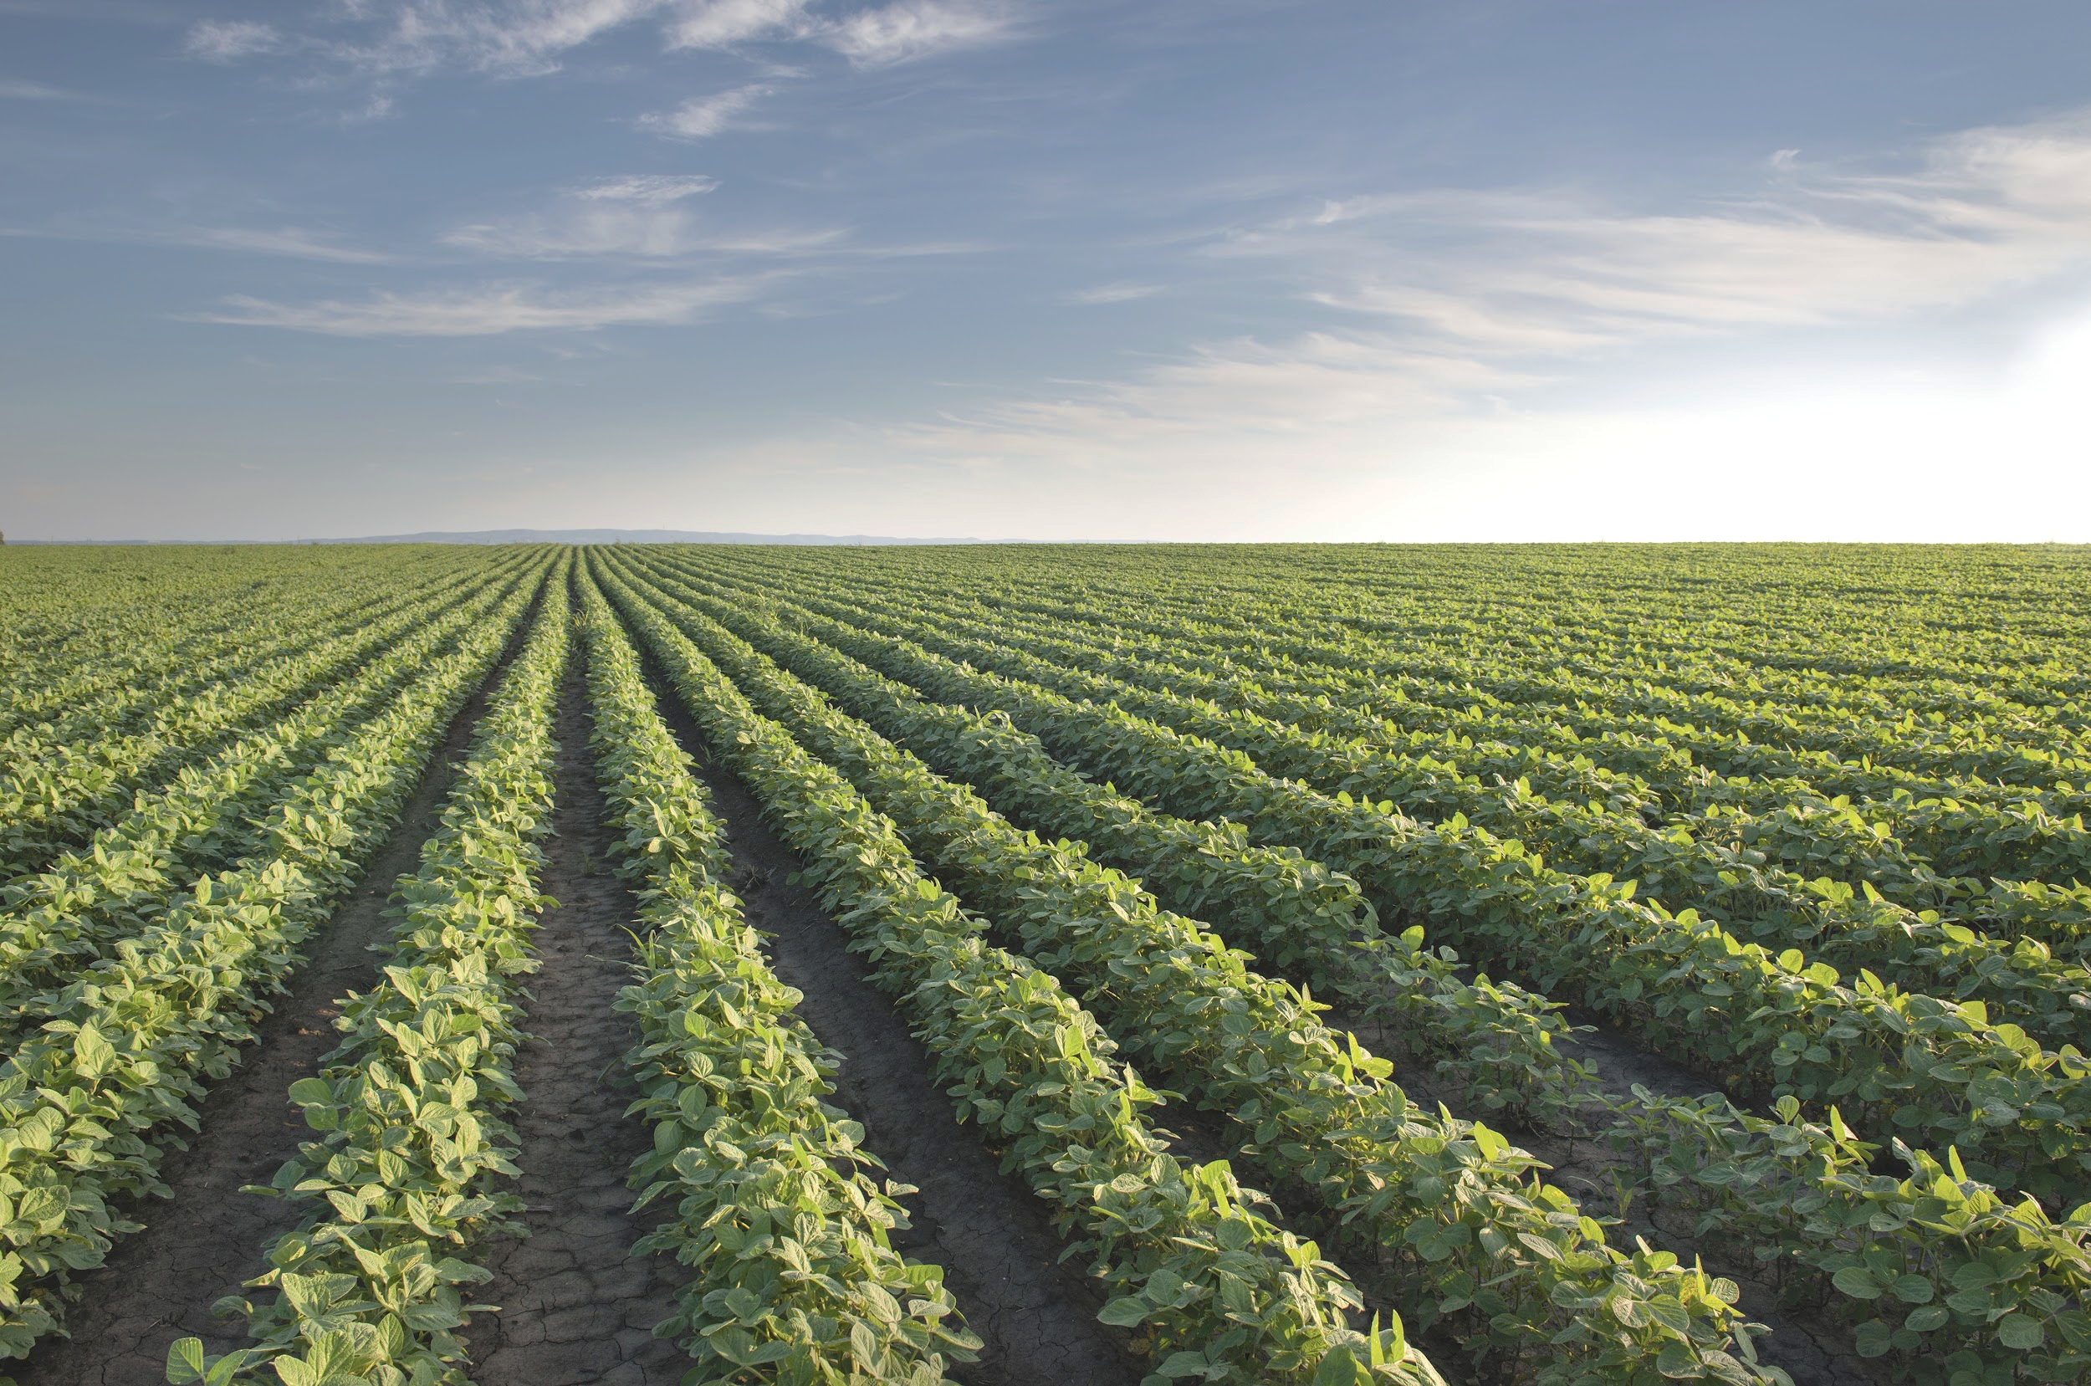

Farm Friend
Crowdfunding for Farms
Neal, Mrinoy, Pulkit, Jacob, Alan

Slide 2
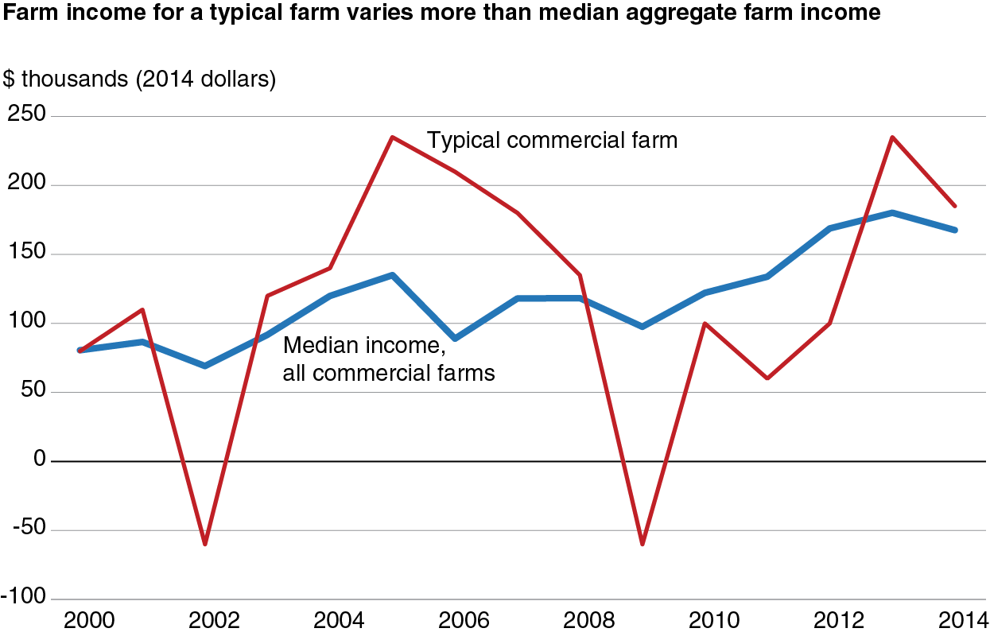
Problem
Farmers do not have enough access to short term capital
Difficult to weather financial storms

Slide 3
Solution
Website that gives investors direct contact with farmers in need of short term liquidity
Connects farmers in need with civic-minded investors
Concept: GoFundMe + Impact Investing

Slide 4




Existing Alternatives

Slide 5
Why Us?
Targeted customer base
Loans on the farmer’s terms, not ours or the investor’s
Emphasis on sustainability and ethical investing

Slide 6
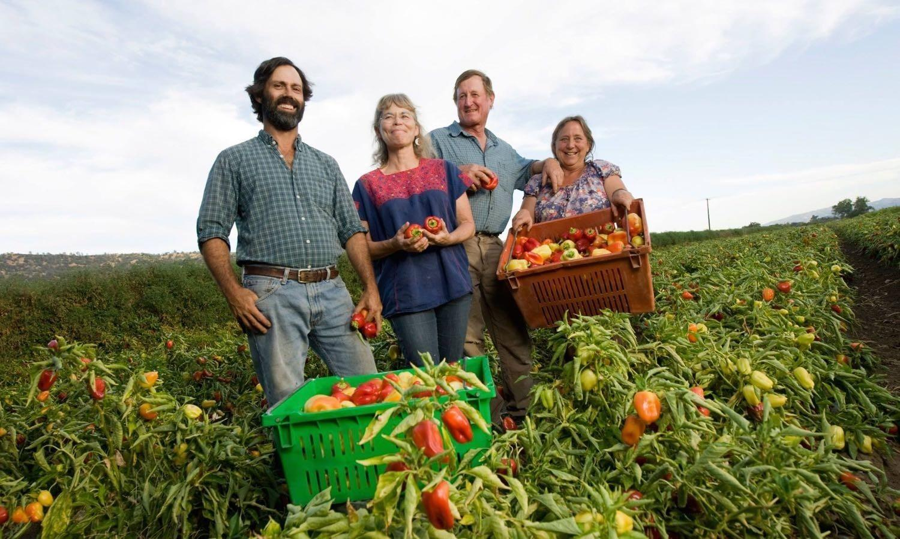
Ideal Clients
Small farmers needing reasonable interest rate loans to continue efficient production
Investors who want to make a positive impact on farming communities

Slide 7
Business Model
Farmer Investment
Fee on Principal: 0.5%
Farm Friend
Interest + Principal
Annual Cost: $312
Principal
Fee
Loans to Breakeven: $62,400
Investor
Market size needed: 0.0078%

Slide 8
How to Reach our Clients
Social media
Community outreach
Networking with prospective clients

Slide 9
Next Steps
Refining our website and fully developing our app
Connect with portfolio managers and private equity investors
Reevaluate and optimize our fee structure

Slide 10

Website Demo

Slide 11
Thank You Farm Friends !

